Slide 1


Files and Input/Output
CS 1181 – Computer Science II
Dr. Michael Raymer
Lecture materials adapted from:
ZyBooks ISBN: 979-8-203-16123-9 Dr. Cay Horstmann, Univ. of Michigan Dr. Roman Lysecky, Univ. of Arizona
Dr. Adrian Lizarraga, Univ. of Arizona
Dr. Travis Doom
Dr. Michelle Cheatham
Unless otherwise noted images are used under the creative commons license or used under license from Adobe Stock.

Slide 2


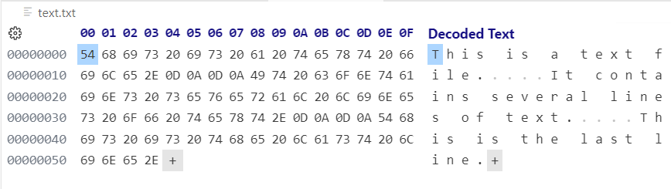
What is really in a file?
This is
a text
file.
It contains several lines of text.
This is the last line.
This·is·a·text·file.↵↵It·contains·several·lines·of·text.↵↵This·is·the·last·line.<eof>

Slide 3
I/O Classes
Java provides a lot of classes to help us more easily go back and forth between a bunch of bits in a file and something useful. You know many of them already.
FileReader
0001011
1101010
1010100
10100100100001001010101010001000100100010101001111001010101110100101010101010101010000101010010000000011
PrintReader
Scanner
FileWriter
PrintWriter

Slide 4
PrintWriter
Writes characters (UTF-8, UTF-16, etc.) to a file using print() and println().
PrintWriter out = new PrintWriter("Names.txt");
out.println("Chris");
out.println("Kathryn");
out.println("Jean");
out.close();
Why do we have to do this?

Slide 5
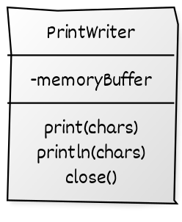

Writing to files is slow!
0001011
1101010
1010100
10100100100001001010101010001000100100010101001111001010101110100101010101010101010000101010010000000011
01001010100010010100100101011101001001010101010010101001010101010101111000010
A buffer is just an array where we store things. This lets us do fewer disk/ssd writes.

Slide 6
Closing files
0001011
1101010
1010100
10100100100001001010101010001000100100010101001111001010101110100101010101010101010000101010010000000011
01001010100010010100100101011101001001010101010010101001010101010101111000010
When we close the file, any remaining bits in the buffer are sent to the file.

Slide 7
What if I have a bunch of numbers?
public static void main(String[] args) {
int values[] = {13, 86, 27, 91, 102, 47, 78, 90};
try {
PrintWriter out = new PrintWriter("numbers.txt");
for(int value : values){
out.println(value);
}
out.close();
}
catch (FileNotFoundException e){
System.out.println("Unable to open file");
return;
}
}

Slide 8
What if I have a bunch of numbers?
toString()
println()
00110001
00110011
00001101
00001010
“1”
00001101
01010110
00011011
01011011
01100110
00101111
01001110
01011010
“13”
“3”
<CR>
<LF>
Not only is this slow, but we’ve (more than) doubled the storage requirement for each number!
0001011
1101010
1010100
10100100100001001010101010001000100100010101001111001010101110100101010101010101010000101010010000000011

Slide 9
Writing binary files
00001101
01010110
00011011
01011011
01100110
00101111
01001110
01011010
Can we simply write the binary representation directly?
0001011
1101010
1010100
10100100100001001010101010001000100100010101001111001010101110100101010101010101010000101010010000000011

Slide 10


Streams
Writers – always write characters (text) to a file
Streams – can write any binary data: numbers, music, images, etc. It is up to the programmer to ensure that the file is read back in correctly!

Slide 11
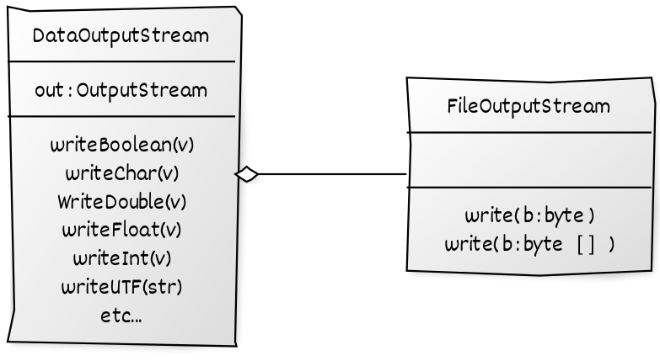
Output Streams
FileOutputStream fs = new FileOutputStream(filename);
DataOutputStream output = new DataOutputStream(fs);
output.writeInt (number);
File
Value
101101
Breaks into bytes
Writes bytes to file
written to
chained to
chained to

Slide 12
Binary Data Files
float myFloat = 7.25f;
double myDouble = 8.333333333;
int myInt = 9;
String myString = "foo";
boolean myBoolean = true;
output.writeFloat(myFloat);
output.writeDouble(myDouble);
output.writeInt(myInt);
output.writeChars(myString);
output.writeBoolean(myBoolean);
7.25f → 32-bit float
8.33… → 64-bit double
9 → 32-bit int
40 E8 00 00 40 20 AA AA AA A7 CD A9 00 00 00 09 00 66 00 6F 00 6F 01
‘f’
‘o’
‘o’
true → 8-bit boolean

Slide 13
Serialization
What do we need to save to load/store an object?
What if the object contains a reference to another object?
We need to flatten the object(s) to a collection of primitive values. This is called serializing the object.

Slide 14
Saving Entire Objects?
Java makes saving (and loading) entire objects easy with class ObjectOutputStream (and ObjectInputStream).
public class Student implements Serializable {
private static final long serialVersionUID = 1L;
private int uid;
private String lastName;
private String firstName;
private float gpa;
…
FileOutputStream fs = new FileOutputStream(dataFile);
ObjectOutputStream output = new ObjectOutputStream(fs);
output.writeObject(me);

Slide 15
Serializable
public class Student implements Serializable {
private static final long serialVersionUID = 1L;
…
Serializable is a marker interface only. It has no methods! It simply lets Java know that this class is ok to serialize.
Java will not load an object saved with a different serialVersionUID. This prevents errors if we change the class and then try to load the old version.

Slide 16
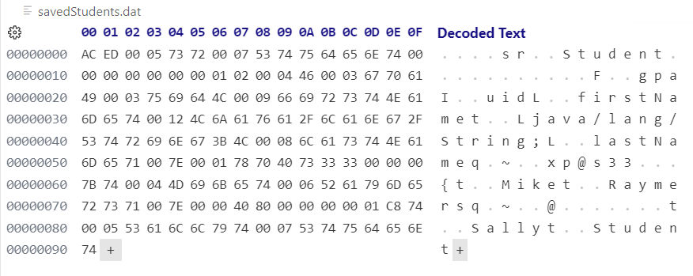

Saving Objects
Student me = new Student(123, "Raymer", "Mike");
me.setGpa(3.8f);
…
output.writeObject(me);

Slide 17
Transient data
The transient keyword tells java not to save a field when an object is serialized.
public class ChatUser implements Serializable {
private static final long serialVersionUID = 1L;
private String lastName;
private String firstName;
private int userID;
private transient String status = "online";
...
}
No need to save status, because it is always set to “online” on startup.

